Slide 1



Algorithm efficiency – Time & space complexity, order of growth Session No.: 03 Course Name: Design and Analysis of Algorithms Course Code: R1UC407B Instructor Name: Dr. Ashwin Perti Duration: 50 mins Date of Conduction of Class: 22/02/2026

Slide 2




Opening Activity (Think – Pair – Share)
You are given an unsorted list of integers.
Which of the sorting algorithms (studied in the previous semester) will you apply and why?

Slide 3

Learning Outcomes
By the end of this session, You will be able to:
Define and explain the significance of algorithmic complexity: Time and space complexity
Analyze and Apply the concept of order of growth in analyzing the algorithms

Slide 4
Session Outline
Time and space complexity
Order of growth
Analyze algorithms for their time and space complexities
Quiz/Activities

Slide 5

Time and Space Complexity
Many times there are more than one ways to solve a problem with different algorithms and we need a way to compare multiple ways.
Also, there are situations where we would like to know how much time and resources an algorithm might take when implemented.
To measure performance of algorithms, we typically use time and space complexity analysis.

Slide 6
Time Complexity
The time complexity of an algorithm quantifies the amount of time taken by an algorithm to run as a function of the length of the input.
The time to run is a function of the length of the input and not the actual execution time of the machine on which the algorithm is running on.

Slide 7
Space Complexity
Problem-solving using computer requires memory to hold temporary data or final result while the program is in execution.
The amount of memory required by the algorithm to solve given problem is called space complexity of the algorithm.
The space complexity of an algorithm quantifies the amount of space taken by an algorithm to run as a function of the length of the input.

Slide 8
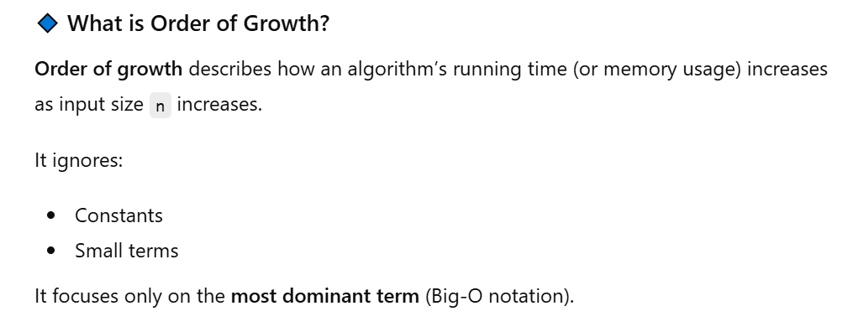
Order of Growth

Slide 9
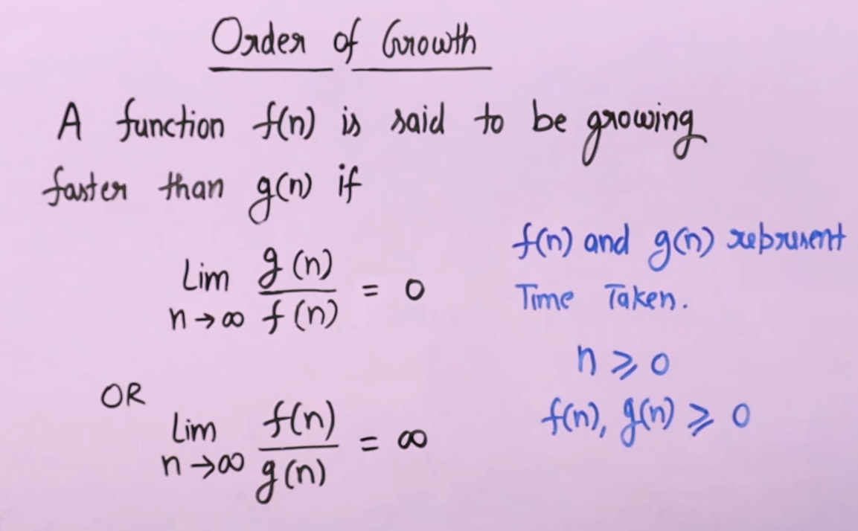
Order of Growth

Slide 10
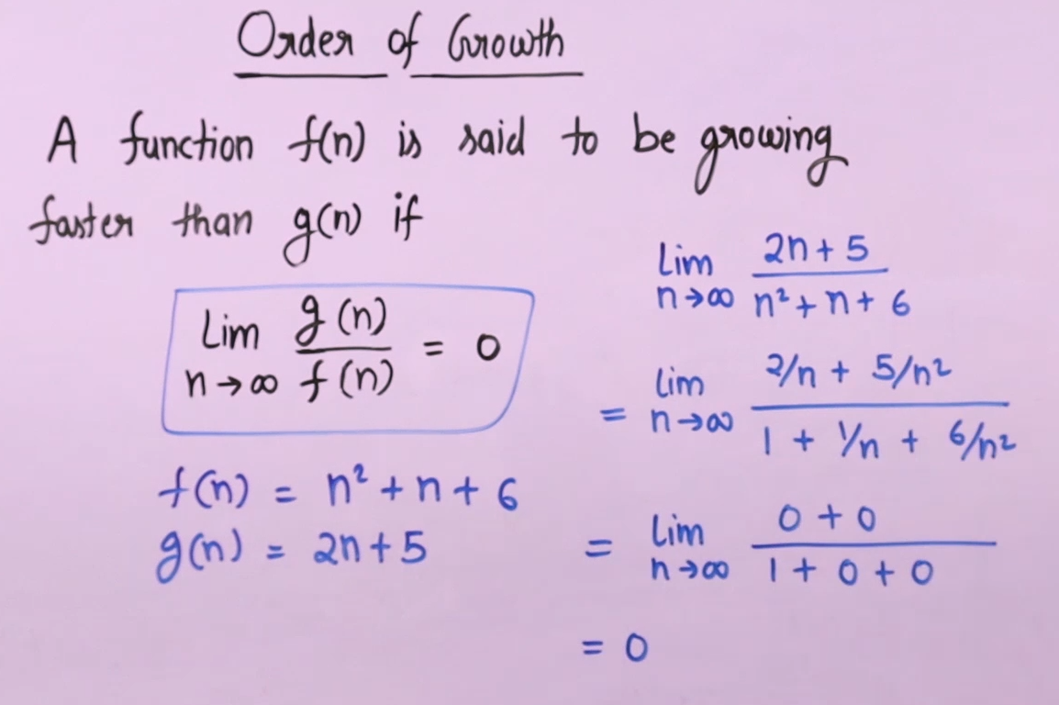
Order of Growth: Example

Slide 11
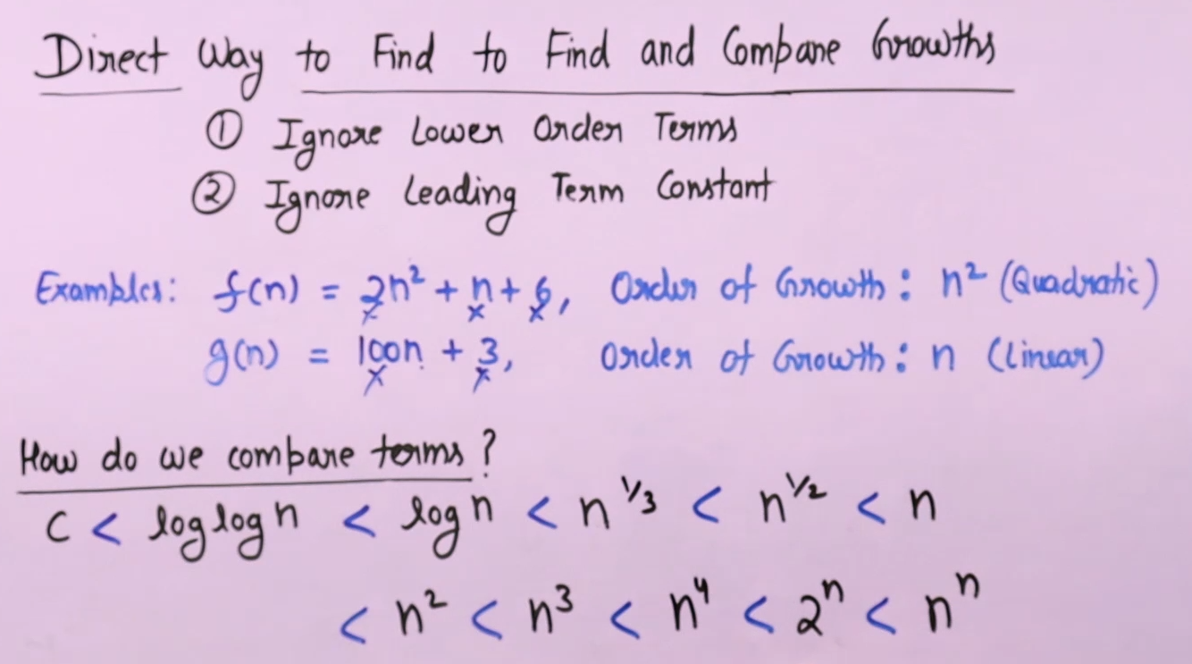
Order of Growth

Slide 12
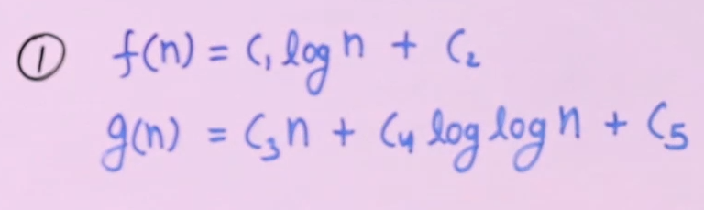
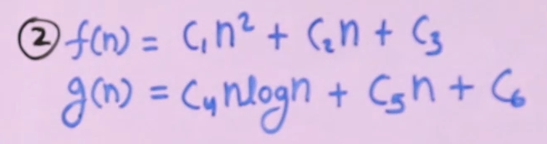
Order of Growth
Exercise: Find the order of growth of the following functions and tell which one is having higher order of growth.

Slide 13
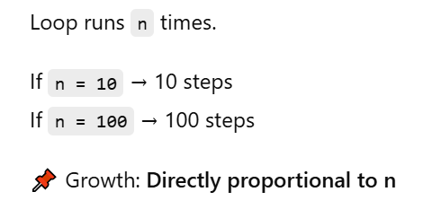
Order of Growth
Example:
Linear Growth — O(n)
int sum(int arr[], int n) {
int total = 0;
for(int i = 0; i < n; i++) {
total += arr[i];
} return total;
}

Slide 14

Activity: Problem Based Learning
Calculate time and space complexity of the following codes:
Example 1:
int getFirst(int arr[]) {
return arr[0];
}
Time Complexity: ?
Space Complexity: ?
Example 2: (Linear Search)
int linearSearch(int arr[], int n, int key) {
for(int i = 0; i < n; i++) {
if(arr[i] == key) return i;
} return -1;
}
Time Complexity: ?
Space Complexity: ?

Slide 15
Activity: Problem Based Learning
Calculate time and space complexity of the following codes:
Example 1:
int getFirst(int arr[]) {
return arr[0];
}
Explanation
No matter how big the array is, we access one element
Time Complexity: O(1)
Space Complexity: O(1)
Example 2: (Linear Search)
int linearSearch(int arr[], int n, int key) {
for(int i = 0; i < n; i++) {
if(arr[i] == key) return i;
} return -1;
}
Explanation
Loop runs up to n times
Time Complexity: O(n)
Space Complexity: O(1)

Slide 16
Calculate time and space complexity of the following codes:
Example 4: (Binary Search)
int binarySearch(int arr[], int n, int key) {
int low = 0, high = n - 1;
while(low <= high) {
int mid = (low + high) / 2;
if(arr[mid] == key) return mid;
else if(arr[mid] < key) low = mid + 1;
else high = mid - 1;
}
return -1; }
Example 3: (Nested Loops)
void printPairs(int arr[], int n) {
for(int i = 0; i < n; i++) {
for(int j = 0; j < n; j++) {
printf("%d %d\n", arr[i], arr[j]);
} } }
Time Complexity: ?
Space Complexity: ?
Time Complexity: ?
Space Complexity: ?

Slide 17
Calculate time and space complexity of the following codes:
Example 4: (Binary Search)
int binarySearch(int arr[], int n, int key) {
int low = 0, high = n - 1;
while(low <= high) {
int mid = (low + high) / 2;
if(arr[mid] == key) return mid;
else if(arr[mid] < key) low = mid + 1;
else high = mid - 1;
}
return -1; }
Example 3: (Nested Loops)
void printPairs(int arr[], int n) {
for(int i = 0; i < n; i++) {
for(int j = 0; j < n; j++) {
printf("%d %d\n", arr[i], arr[j]);
} } }
Time Complexity: O(n²)
Space Complexity: O(1)
Time Complexity: O(log n)
Space Complexity: O(1)

Slide 18
Activity: Problem Based Learning
Calculate time and space complexity of the following code:
Example 5: (Using an Extra Array)
void copyArray(int arr[], int n) {
int copy[n]; // extra array of size n
for(int i = 0; i < n; i++) {
copy[i] = arr[i];
}
for(int i = 0; i < n; i++) {
printf("%d ", copy[i]);
}
}
Time Complexity: ?
Space Complexity: ?

Slide 19
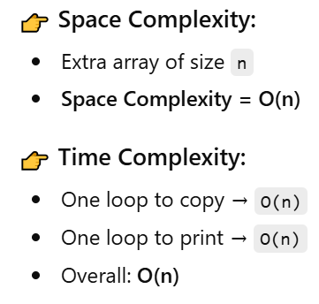
Activity: Problem Based Learning
Calculate time and space complexity of the following code:
Example 5: (Using an Extra Array)
void copyArray(int arr[], int n) {
int copy[n]; // extra array of size n
for(int i = 0; i < n; i++) {
copy[i] = arr[i];
}
for(int i = 0; i < n; i++) {
printf("%d ", copy[i]);
}
}

Slide 20

Assessment:Quiz

Slide 21
Learning Outcomes
[2-mins]
Ensure attainment of LO’s in alignment to the learning activities:
Define and explain the significance of algorithmic complexity: Time and space complexity
Analyze and Apply the concept of order of growth in analyzing the algorithms

Slide 22
Next Session:
Analysis of algorithmic efficiency: Asymptotic notations and their properties.

